Slide 1
Cortex M4 Assembly Language
Girish S Kumar
Notes:
Click to add notes

Slide 2
Instructions for ARM Cortex-M4
For any Processor to perform a task user has to give instructions
High level languages like C/C++ which are closer to English In such a case a compiler translates the high level instructions to a machine language
This kind of language is composed of binary code or machine code
sequence, like 01101110. The low-level language is a computer- or machine-dependent
language.

Slide 3
Assembly Language Work Flow
Assembly Language Instructions
Assembler
Machine Language Instructions

Slide 4
ARM and Thumb® Instruction Set
Early ARM instruction set
32-bit instruction set, called the ARM instructions
Powerful and good performance
Larger program memory compared to 8-bit and 16-bit processors
Larger power consumption
Thumb-1 instruction set
16-bit instruction set, first used in ARM7TDMI processor in 1995
Provides a subset of the ARM instructions, giving better code density compared to 32-bit RISC architecture
Code size is reduced by ~30%, but performance is also reduced by ~20%

Slide 5
ARM and Thumb Instruction Set
Mix of ARM and Thumb-1 Instruction sets
Benefit from both 32-bit ARM (high performance) and 16-bit Thumb-1 (high code density)
A multiplexer is used to switch between two states: ARM state (32-bit) and Thumb state (16-bit), which requires a switching overhead
Thumb-2 instruction set
Consists of both 32-bit Thumb instructions and original 16-bit Thumb-1 instruction sets
Compared to 32-bit ARM instructions set, code size is reduced by ~26%, while keeping a similar performance
Capable of handling all processing requirements in one operation state
Incoming
Instructions
0
ARM
Instruction
decoder
Instructions
Executing
Thumb remap
to ARM
1
T bit, 0: select ARM,
1: select Thumb

Slide 6
Cortex-M4 Instruction Set
Cortex-M4 processor
ARMv7-M architecture
Supports 32-bit Thumb-2 instructions
Possible to handle all processing requirements in one operation state (Thumb state)
Compared with traditional ARM processors (use state switching), advantages include:
No state switching overhead – both execution time and instruction space are saved
No need to separate ARM code and Thumb code source files, which makes the development and maintenance of software easier
Easier to get optimised efficiency and performance

Slide 7
Cortex-M4 Instruction Set
ARM assembly syntax:
label
mnemonic operand1, operand2, … ; Comments
Label is used as a reference to an address location;
Mnemonic is the name of the instruction;
Operand1 is the destination of the operation;
Operand2 is normally the source of the operation;
Comments are written after “ ; ”, which does not affect the program;
For example
MOVS R3, #0x11 ;Set register R3 to 0x11
Note that the assembly code can be assembled by either ARM assembler (armasm) or assembly tools from a variety of vendors (e.g. GNU tool chain). When using GNU tool chain, the syntax for labels and comments is slightly different

Slide 8
High level Language Work Flow
High Level Language -C
C- Compiler
Assembler
Machine Language Instructions

Slide 9
Stage of a compiler
High Level Program
Lexical Analyzer
Parser
Intermediate Code
Processor Specific Assembly Language
Machine Language Instructions
ARM Assembler

Slide 10
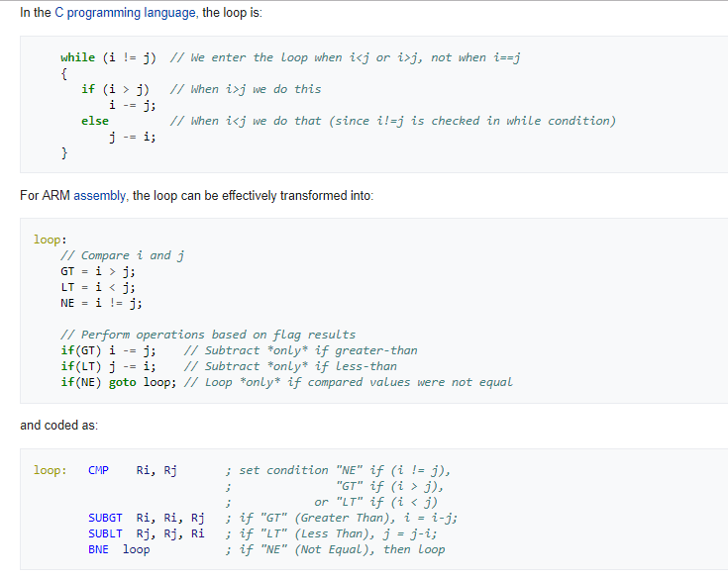
A Typical ARM Compilation

Slide 11
ARM Instructions set
ARM instructions are always 32 Bit
Op Code and data is contained in this
Op-Code 20 bits
Operands 12 bit
32 -Bits
Notes:
How presentation will benefit audience: Adult learners are more interested in a subject if they know how or why it is important to them.
Presenter’s level of expertise in the subject: Briefly state your credentials in this area, or explain why participants should listen to you.

Slide 12
ARM Thumb-2 Instructions
ARM developed two different instruction set architectures:
Traditional 32-bit instruction set (ARM Instructions)
16-bit instructions to improve the code Density (Thumb Instructions)
During 2003 ARM developed Thumb-2 technology This technology enables a mixture of 16-bit and 32-bit instructions to be executed within one operating state. All the ARM Cortex-M processors are based on Thumb-2 technology.

Slide 13
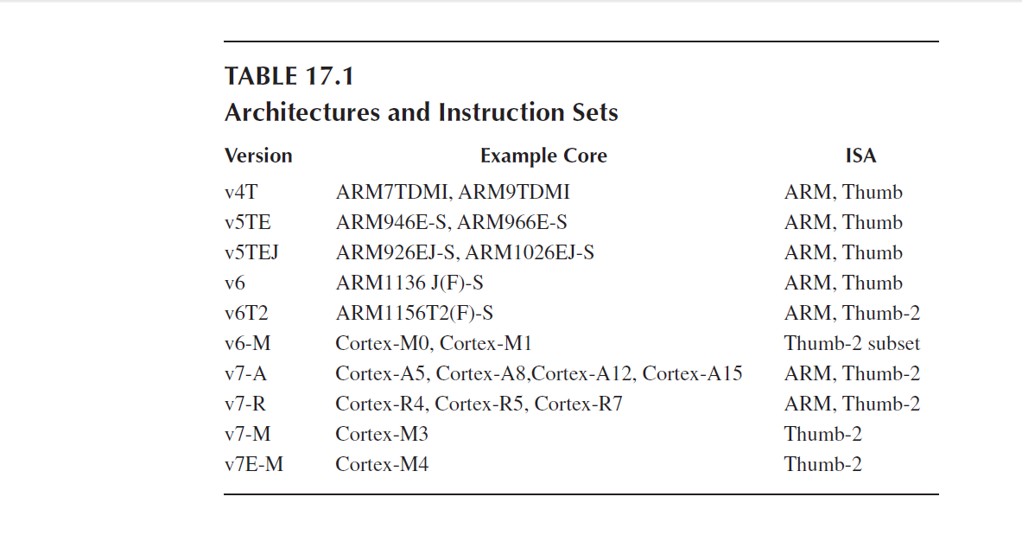

Slide 14
Cortex M4 Instructions Set
Cortex M4 has
203 Instructions in general category
65 instructions related to FPU
1. Data Moving Instructions
2. Arithmetic Instructions
3. Logic Instructions
4. Shift and Rotate Instructions
5. Data Conversion Instructions
6. Bit-Field Processing Instructions
7. Compare and Test Instructions
8. Program Flow Control Instructions
9. Saturation Instructions
10. Exception Related Instructions
11. Sleep Mode Instructions
12. Memory Barrier Instructions
13. Miscellaneous Instructions
14. Unsupported Instructions

Slide 15
Syntax of Assembly Language
1. Label field
2. Operation field
3. Operands field
4. Comment field
 | Label Field | Operation Field | Operands | Comments
Mandatory/Optional | Optional | Mandatory | Mandatory | Optional
Purpose | Identify a line for branching A label must be located at the first column & max 15 Chars Label must end with a : | Contains the Mnemonic like MOV, ADD | The operands field contains the data or an address for its corresponding instruction to be operated | To add documentation to your should be mentioned after a semicolon

Slide 16
Instruction Format
{label} {instruction|directive|pseudo-instruction} {;comment}
ARM INSTRUCTION
OPERANDS
Represents Address of some location in memory
Linker will calculate the address
OPTIONAL

Slide 17
A Sample Program
AREA myfirst, CODE, READONLY
EXPORT __main
ENTRY
__main FUNCTION
MOV R0, #10
MOV R1 , #3
ADD R0, R0, R1
stop B stop ; stop program
ENDFUNC
END

Slide 18
Rules for third field- Operands
For data processing instructions written for the ARM assembler, the first operand is the destination of the operation.
• For a memory read instruction,, the first operand is the destination register that data is to be loaded into.
• For a memory write instruction, the first operand is the source register that holds the data to be written into the memory.
• For a multiple load instruction, the register list which is the third operand is the destination operand that the data will be loaded into.
• For a multiple store instruction, the register list which is the third operand is the source operand that the stored data will be written into the memory.

Slide 19
What are directives
Directive as special Keywords which tells the assembler about various parts of assembly language code you had written
This changes with assembler, in this session, we are only discussing directives specific to KEIL tools.
This is because the assembler need to know which is code and which is data so that the code/instructions can be stored in READ ONLY memory and data can be stored in READ and WRITE memory area.

Slide 20
Defining a block of code/data
KEYWORD : AREA
How to use:
AREA <name of the section> {attribute-1}{attribute-2} ……
Function : Tells the assembler to start section of code or data area with the given name. name of the session can be anything
Attribute name | Description
CODE | Machine code READONLY Is default
DATA | Section for Data- READWRITE by default
READONLY | TO be placed in Read only memory
READWRITE | To be placed in READ write memory
ALIGN = expr | Align the section on 2^expr boundary. If expr =10 the section is aligned to a 1KB boundary

Slide 21
ARM Register Name defintions
KEYWORD : RN
How to use:
somename : RN <0 to 15>
Function : Tells the assembler to assign the somename to the CPU register which is numbered from 0 to 15
Example
diameter RN 8 ; Register 8 can be called by name diameter in your code
area RN 0 ; register 0 can be called by name area

Slide 22
Equating symbol to a numeric constant
KEYWORD : EQU
How to use:
somename : EQU exptr {,type}
Function : Tells the assembler to assign the somename to a numeric constant or to a register relative value or program relative value. Similar to #define in C
expr can be
register relative value
program relative
address
32-bit integer constant
type can be
ARM
THUMB
CODE16
CODE32
DATA

Slide 23
Examples
SRAM_BASE EQU 0x04000000 ; assign SRAM a base address
pqr : EQU 4
startloop : EQU label + 8 ; assign the address label + 8 to symbol
startloop
myname : EQU 0x1C, CODE32 ;assign absolute address 0x1C to symbol
myname and mark it as CODE

Slide 24
Declaring an Entry point
KEYWORD : ENTRY
How to use:
ENTRY
Function : Tells the assembler to where the program has to start its execution from. Every program has to have an entry point. This is specifically needed when the code is written in multiple file

Slide 25
Allocating Memory and specifying Contents
KEYWORD : DCB
How to use:
{label} : DCB expr {,expr}
Function : Tells the assembler to configure memory which contains tables or data, before the program runs. String, floating point constants, addresses can be stored in memory as a data using this directive
DCB operatiers are byte level where DCW operates at two byte boundaries
dataconstant DCB 0xe
This will configure a memory of size 0xe

Slide 26
What is data alignment
Data structure alignment is the way data is arranged and accessed in computer memory. When a modern computer reads from or writes to a memory address, it will do this in word sized chunks, typically 32 bits or 64 bits on modern systems. Data alignment means putting the data at a memory address equal to some multiple of the word size, which increases the system's performance due to the way the CPU handles memory.
To align the data to the word boundaries, it may be necessary to insert some unused bytes between the end of the last data structure and the start of the next, which is data structure padding.

Slide 27
Aligning code and data to appropriate boundaries
KEYWORD : ALIGN
How to use:
ALIGN {expr {,offset}}
Function : Tells the assembler to align current location fo a specified boundary by padding with zeros
Expr is a numeric expression evalvating to any power of 2 from 2^0 to 2 ^31 3nd offset can be any numeric expression.

Slide 28
Data Insertion and Alignment
Insert data inside programs
DCD: insert a word-size data
DCB: insert a byte-size data
ALIGN:
used before inserting a word-size data
Uses a number to determine the alignment size
For example
…
ALIGN 4 ; Align to a word boundary
MY_DATA DCD 0x12345678 ; Insert a word-size data
MY_STRING DCB “Hello”, 0 ; Null terminated string
…

Slide 29
RESERVING a block of memory
KEYWORD : SPACE
How to use:
{label} : SPACE expr
Function : Tells the assembler to reserve a block of memory for variables, tablesor storing data during routines expr is the number of bytes that need to be reserved
Example :
AREA mydataspace, DATA, READWRITE
Data1 SPACE 255 ; reserves 255 bytes of data

Slide 30
Ending a source file
KEYWORD : END
How to use:
END
Function : Tells the assembler that this is end of the source code

Slide 31
Shifting Data
AREA appcode, CODE, READONLY
EXPORT __main
ENTRY
__main FUNCTION
MOV r0, #0x11 ; load initial value
LSL r1, r0, #1 ; shift 1 bit left
LSL r2, r1, #1 ; shift 1 bit left
stop B stop ; stop program
ENDFUNC
END
Notes:
Lesson descriptions should be brief.

Slide 32
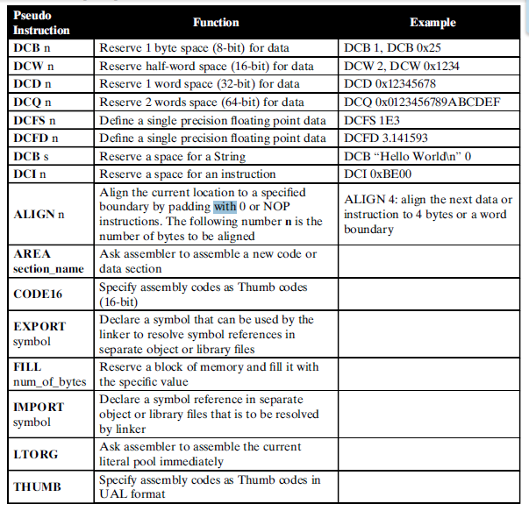
Popular pseudo
instructions used in
Cortex-M4 MCU

Slide 33
Swapping Registers
THUMB
AREA appcode, CODE, READONLY
EXPORT __main
ENTRY
__main FUNCTION
MOV r0, #0x100
MOV r1, #0x200
EOR r0, r0, r1 ; r0 XOR r1
EOR r1, r0, r1 ; r1 XOR r0
EOR r0, r0, r1 ; r0 XOR r1
stop B stop ; stop program
ENDFUNC
END
Notes:
Example objectives
At the end of this lesson, you will be able to:
Save files to the team Web server.
Move files to different locations on the team Web server.
Share files on the team Web server.

Slide 34
Cortex-M4 Instruction Set
Cortex-M4 Suffix
Some instructions can be followed by suffixes to update processor flags or execute the instruction on a certain condition
Suffix | Description | Example | Example explanation
S | Update APSR (flags) | ADDS R1, #0x21 | Add 0x21 to R1 and update APSR
EQ, NE, CS, CC, MI, PL, VS, VC, HI, LS, GE, LT, GT, LE | Condition execution e.g. EQ= equal, NE= not equal, LT= less than | BNE label | Branch to the label if not equal

Slide 35
Factorial
THUMB
AREA factorial, CODE, READONLY
EXPORT __main
ENTRY
__main FUNCTION
MOV r6,#10 ; load n into r6
MOV r7,#1 ; if n = 0, at least n! = 1
loop CMP r6, #0
MULGT r7, r6, r7
SUBGT r6, r6, #1 ; decrement n
BGT loop ; do another mul if counter!= 0
stop B stop ; stop program
ENDFUNC
END

Slide 36



Cortex-M4 Addressing Modes

Slide 37
Seven Addressing Modes
1. Immediate Offset Addressing Mode
2. Register Offset Addressing Mode
3. PC-Relative Addressing Mode
4. Load and Store Multiple Registers Addressing Mode
5. PUSH and POP Register Addressing Mode
6. Load and Store Register Exclusive Addressing Mode
7. Inherent Addressing Mode

Slide 38
Immediate offset Addressing mode
Target address to do a memory operation LOAD or STORE is obtained by
adding an offset to a base address that is stored in a register.
The offset value can be positive or negative, any general-purpose register
R0 to R12 can be used to store the base address.
Memory
Address | Data
0x01003 | 0x4573
0x01004 | 0x6789
0x01005 | 0x4128
Base address Register
Any one from (R0-R12)
+
Offset

Slide 39
Variations of Offset Addressing
1. Regular Immediate Offset Addressing Mode
2. Pre-Indexed Immediate Offset Addressing Mode
3. Post-Indexed Immediate Offset Addressing Mode
4. Regular Immediate Offset Addressing Mode with
Unprivileged Access

Slide 40
Regular Immediate Offset Addressing Mode
MOV R2, 0x00340
LDRB R0, [R2, #0x5]
In this mode, the offset is an immediate number and the
content of the register R2 keeps unchanged after the execution
of this instruction.
The range of the offset depends on the operation mode used in
the instruction. For the regular Immediate Offset mode, the offset
is ranged -255 to 4095.
The square bracket [ ] covering the R2 and an Offset indicates that
the combination of the content of the R2 and the Offset is a
valid memory address.

Slide 41
Example of Shifting Data with Regular Immediate Offset Addressing Mode
AREA appcode, CODE, READONLY
EXPORT __main
ENTRY
__main FUNCTION
MOV R2, #0x20000000 ; Base Address
LDR R0, [R2, #0x5] ; 0x5 is the offset
LSL r1, r0, #1 ; shift 1 bit left
LSL r2, r1, #1 ; shift 1 bit left
stop B stop ; stop program
ENDFUNC
END

Slide 42
Load Instruction
LDR{type} Rd, [Rn, {#Offset}]
Base Register
Size and Type of
Data Loaded
Destination Register
Instruction | Size & type
LDR | 32 Bit
LDRB | Unsigned byte
LDRH | Unsigned half word (16 bits)
LDRSB | Signed byte
LDRSH | Signed Half Word

Slide 43
Pre-Indexed Immediate Offset Addressing Mode
LDR{type} Rd, [Rn, {#Offset}]!
The target memory address is first calculated by adding the content of the
register Rn and the Offset (Pre-Indexed).
2. Then the data item stored in that target address will be loaded into the
destination register Rd The effective target address is written back into Rn
The difference between this mode and the Regular immediate offset mode
is that the content of the register Rn is modified after running this instruction

Slide 44
Example of Shifting Data with Pre-index Offset Addressing Mode
AREA appcode, CODE, READONLY
EXPORT __main
ENTRY
__main FUNCTION
MOV R2, #0x20000000 ; Base Address
LDRB R0, [R2, #0x5]! ; 0x5 is the offset
LSL r1, r0, #1 ; shift 1 bit left
LSL r2, r1, #1 ; shift 1 bit left
stop B stop ; stop program
ENDFUNC
END

Slide 45
Post-Indexed Immediate Offset Addressing Mode
LDR{type} Rd, [Rn], {#Offset}
In this mode target memory address is directly obtained from the register Rn without
using the Offset value.
Then use this address as the target memory address to access the memory to
perform either loading or storing operations.
After the instruction is executed, a combination of the content of the register Rn
and the offset is performed, and this sum is sent back to the register Rn.
This means that the content of the register Rn is modified or changed after (post)
this mode’s instruction is executed.

Slide 46
Example of Shifting Data with Pre-index Offset Addressing Mode
AREA appcode, CODE, READONLY
EXPORT __main
ENTRY
__main FUNCTION
MOV R2, #0x20000000 ; Base Address
LDRB R0, [R2], #0x5 ; 0x5 is the offset
LSL r1, r0, #1 ; shift 1 bit left
LSL r2, r1, #1 ; shift 1 bit left
stop B stop ; stop program
ENDFUNC
END

Slide 47
Regular Immediate Offset Addressing Mode with Unprivileged Access
LDR{type}T Rd, [Rn,{#Offset}]
Eg: LDRBT R0, [R2, #0x5];
These load and store instructions perform the same function as the Regular Immediate
Offset Addressing Mode did.
The difference is that these instructions have only unprivileged access even when
used in the privileged software.
When used in the unprivileged software, these instructions perform exactly the same
function as regular memory access instructions with immediate offset.

Slide 48
Store Instruction
STR {type} Rs, [Rn, {#Offset}]
Base Register
Size and Type of
Data Loaded
Data Source Register
Instruction | Size & type
STR | 32 Bit
STRB | Unsigned byte
STRH | Unsigned half word (16 bits)
Addressing mode works the same in LOAD and STORE Instructions

Slide 49
PC-Relative Addressing Mode

Slide 50
PC-Relative Addressing Mode
The PC-relative addressing mode can be used to load a register with a value stored
in program memory a “short distance” away from the current instruction. It can be
seen as a special case of the "base plus offset" addressing mode, .Here the difference
is base address is taken as current value of PC.
There are a few CPUs that support PC-relative data references.
Such CPUs include:
Intel Architecture
ARM Architecture
Motorola 68000 Series
Compilers uses mode of address to to places constants in Literal Pool immediately
Before of after a subroutine that uses it, this mode is used when a constant value is
Used when the constant Part of the instructions

Slide 51
Loading Constants in Registers
Easiest way to load a constant to Register is to use LDR as pseudo instruction
LDR <Register Name> , = <Numeric Constant>
Eg:
LDR R8, =0x20000040
When assembler sees this pseudo instruction it creates MOV instruction to do so. But assembler creates Literal Pools to store constants and this will be located somewhere close to the instructions in the memory. The compiler knows where the literals so to access the literals it generates an address relative to Program Counter (Says PC + 4 or PC =2 etc). But the problem with this approach is the value offset (what we add to PC) cannot be more that 12 bits, in ARM this offset is limited to 12 Bits., that is max (4KB) So in program which is long enough such that the Literal Pool is kept far away more that 4KB will have a problem
Note : 2 ^ 12 = 4096 4096/1024 = 4

Slide 52
How do we solve this
We solve this using an assembler directive LTORG. The LTORG instructs assembler to create the Literal Pool closes to where it is mentioned in this case the Literal pool will be created between the sub-routine
AREA appcode, CODE, READONLY
EXPORT __main
ENTRY
__main FUNCTION
BL func1 ; call first subroutine
BL func2 ; call second subroutine
stop B stop ; terminate the program
; Subroutine func1 begins
func1 LDR r0, =42 ; => MOV r0, #42
LDR r1, =0x12345678 ; => LDR r1, [PC, #N]
; where N = offset to literal pool 1
LDR r2, =0xFFFFFFFF ; => MVN r2, #0
BX lr ; return from subroutine
LTORG ; literal pool 1 has 0x12345678
; Subroutine func2 begins
func2 LDR.W r3, =0x12345678 ; => LDR r3, [PC, #N]
; N = offset back to literal pool 1
;LDR r4, =0x98765432 ; if this is uncommented, it fails.
; Literal pool 2 is out of reach!
BX lr ; return from subroutine
BigTable
SPACE 4200 ; clears 4200 bytes of memory,
; starting here
ENDFUNC
END

Slide 53
Disassembly Window
0x00000108 F000F803 BL.W 0x00000112
0x0000010C F000F80A BL.W 0x00000124
0x00000110 E7FE B 0x00000110
0x00000112 F04F002A MOV r0,#0x2A
0x00000116 4902 LDR r1,[pc,#8] ; @0x00000120
0x00000118 F04F32FF MOV r2,#0xFFFFFFFF
0x0000011C 4770 BX lr
0x0000011E 0000 DCW 0x0000
0x00000120 5678 DCW 0x5678
0x00000122 1234 DCW 0x1234
0x00000124 F85F3008 LDR.W r3,[pc,#-8] ; @0x00000120
0x00000128 4770 BX lr
Explain this with pipe lining effect ……

Slide 54
4. Load and Store Multiple Registers Addressing Mode
What do we do if want to Load or Store a list of memory location to or from
Registers ? We use LDR and STR instructions in a loop, but ARM provides
Instructions to do this – so it more efficient that using loops
LDM{mode} Rn{!}, {reglist};
Eg: LDM R0!, {R1, R2, R3};
STM{mode} Rn{!}, {reglist};
Eg: STMDB R1!, {R3–R6, R11, R12};

Slide 55
LOAD MULTPILE Locations to Registers
Mode mean :
IA: Increment the target address After the Load or Store operation
DB: Decrement the target address Before the Load or Store operation
LDM{mode} Rn{!}, {reglist};
Name of the Register which contains the starting address from where the load instruction should start
List of Register to which the data from memory should be loaded
Value Last address from where Load was done + 1 will be written to Rn

Slide 56
STORE MULTPILE Locations to Registers
Mode mean :
IA: Increment the target address After the Load or Store operation
DB: Decrement the target address Before the Load or Store operation
STM{mode} Rn{!}, {reglist};
Name of the Register which contains the starting address from where the load instruction should start
List of Register to which the data from memory should be loaded
Value Last address from where Load was done + 1 will be written to Rn

Slide 57
Limitations
The register Rn cannot be PC.
• The reglist cannot contain SP.
• In any STM instruction, the reglist cannot contain PC.
• In any LDM instruction, the reglist cannot contain PC if it contains LR.
• The reglist must not contain Rn if you specify the write back suffix
when PC is in the reglist in an LDM instruction:
• Bit[0] of the value loaded to the PC must be 1 for correct execution, and a branch occurs to this half word-aligned address.
• If the instruction is conditional, it must be the last instruction in the IT block.

Slide 58
Exercise
Can you Think of writing a small program using ARM Assembly instructions using
STM and LDM and its variations which will implement
Full ascending stack
Full descending stack

Slide 59
PUSH and POP Register Addressing Mode

Slide 60
Stack Operations
In the Cortex-M4 memory system, the stack uses a full-descending operation mode.
Stack pointer SP points to the bottom or the largest address of the stack area at the beginning or after the system is reset.
After each PUSH operation, the processor first decrements the Stack pointer (SP) by 4, and then it stores the data (32-bit) in the memory location pointed by SP.
In a POP operation, the data of the memory location pointed by SP is read, and then the SP is incremented by 4.

Slide 61
How does PUSH and POP works.
Initially the Stack Pointer register SP is initialized to point to the bottom of the stack by
assigning 0x20007FFF to the SP.
2. After some pushing and popping operations, some data items are pushed
into the stack space the SP now points to the current address 0x20007000
where some data are stored.
3. Before performing the PUSH operation, the content on the SP will be first
decreased by 4 to adjust the SP to point to a new address 0x20006FFC to reserve
4 contiguous bytes to store a 32-bit data or instruction.
4. Then the PUSH instruction is executed to push 4 bytes, MSB, MS, LS, and
LSB, into the stack area starting from the lower address 0x20006FFC which is
pointed by the SP.
5. When the PUSH operation is done, the SP points to the Most Significant Byte
(MSB) with the lower address 0x20006FFC. When the next PUSH operation is
executed, first the SP performs another 4 operation, and it follows the same
operational procedure as above to push another data or instruction into the stack
space.

Slide 62
Some funny words
1 | FACE
2 | DEAD
3 | BEEF
4 | FEED
5 | CAFE
6 | DEED
7 | DECAF

Slide 63
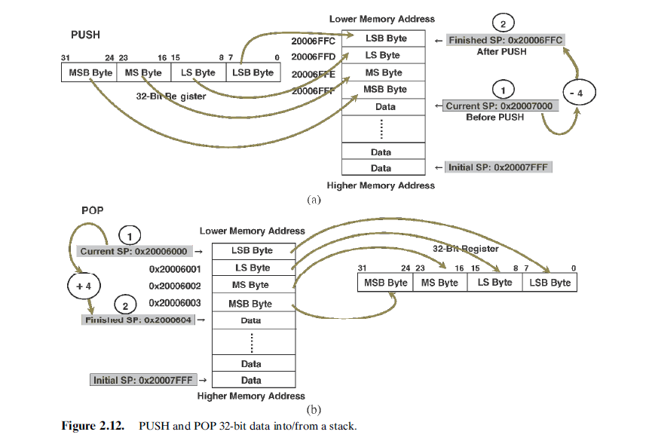

Slide 64
PUSH and POP instruction
PUSH Instruction is very similar to STMDB
POP is very similar to LDMIA
PUSH { list of registers to push to stack };
Example : PUSH {R0, R3–R5, R9};
POP {list of registers to push to stack};
Example POP {R2, R3};
Restrictions with PUSH and POP
The <List of registers> in PUSH or POP cannot contain SP.
• For the PUSH instruction, the <List of registers> cannot contain PC.
• For the POP instruction, the <List of registers> cannot contain PC if it contains LR.

Slide 65
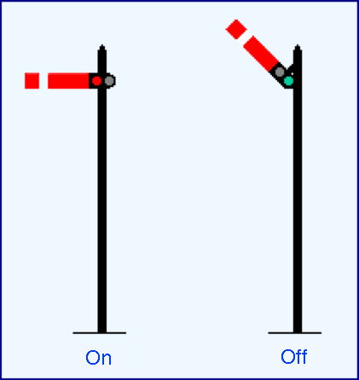
Semaphore in ARM Assembly ?

Slide 66
Exclusive Access to Resources
Let us say we have small device say a printer or something like that connected to a ARM processor Board .. This is memory mapped device
Multiple points, try too access this device. At a time we only one thread can access this device – how do we control this ? In high level language we have Semophore API. In Assembly ARM support this by providing two instructions LDREX STREX for accessing memory.
When we execute LDREX R0, [R1, #0x12]; The memory location with address R1 + 0x12 is read to R0 and the location is “Locked” so that no entity can access it.
When we do a STREX Rd, Rt, [Rn, #Offset]; data in Rt will be written to the address [Rn + Offset], and Rd will have the return status and ”lock” will be released.

Slide 67
Inherent Addressing Mode
Inherent Addressing Mode means that both operands are registers and all
operational data are located inside registers without needing to access the memory space.
Most Arithmetic and Logic as well as Shift and Rotate instructions use this addressing mode, such as the instructions ADD

Slide 68
Floating Point Numbers

Slide 69
Floating point and integers Mix

Slide 70
Structure of Assembly Language Programs Assembler Rules and Directive

Slide 72
Load and Store
Instructions

Slide 74
Arithmetic Operations
Basics of DSP

Slide 76
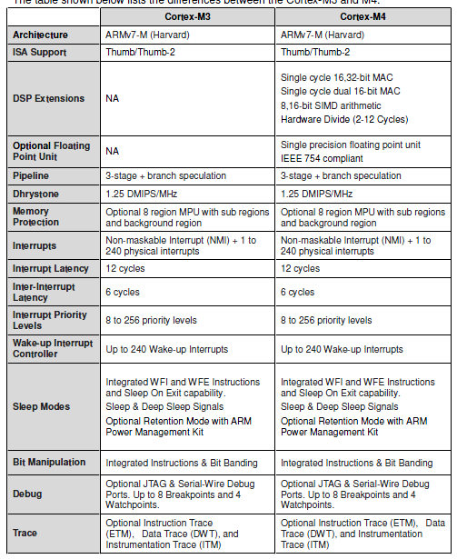
Cortex-M3 and M4

Slide 77
Useful Resources
Architecture Reference Manual:
http://infocenter.arm.com/help/index.jsp?topic=/com.arm.doc.ddi0403c/index.html
Cortex-M4 Technical Reference Manual:
http://infocenter.arm.com/help/topic/com.arm.doc.ddi0439d/DDI0439D_cortex_m4_processor_r0p1_trm.pdf
Cortex-M4 Devices Generic User Guide:
http://infocenter.arm.com/help/topic/com.arm.doc.dui0553a/DUI0553A_cortex_m4_dgug.pdf

